Slide 1
Managing Data Security in Organizations and Preventing Ransomware Attacks with AI
By: Shanysse Alexander

Slide 2
Abstract
I developed and compared machine learning models for predicting malicious activities, such as ransomware or unauthorized access, using a dataset that includes features related to benign and BitcoinAddresses classifications.
This research was important to learn how to better improve detection systems for cybersecurity threats and classifying benign and malicious events.
I used four classification models—Naive Bayes, K-Nearest Neighbors, Decision Tree, and Logistic Regression.

Slide 3
Problem Statement
Ransomware attacks pose a growing threat to organizational data security, causing financial losses, operational shutdowns, and data breaches.
Traditional security systems struggle to keep up with the increasingly sophisticated techniques hackers use.

Slide 4
Problem Statement Solution
In the project I will cover four different AI models that can protect against ransomware attacks
These models include, Naive Bayes, K-Nearest Neighbors, Decision Tree, and Logistic Regression.

Slide 5
Prior Work
Antivirus software, intrusion detection systems, and network security protocols have been the standard tools for protecting against ransomware
These methods cannot help prevent attacks only identify them.

Slide 6
Prior Work Cont’d
Previous research has shown that AI models, like machine learning algorithms, can help detect malicious behavior by analyzing large datasets and recognizing patterns.
Researchers of AI in cybersecurity have seen improvements in detecting threats.

Slide 7
Research Approach
Understanding the models before I used them is beneficial in building the actual code that uses them.
Logistic regression permits the use of continuous or categorical predictors and provides the ability to adjust for multiple predictors which is why it had the most success during the testing.
The Decision Tree model did not have as much success, because it is subject to overfitting and underfitting.

Slide 8
Research Approach Cont’d
I preprocessed the data by scaling numeric features and encoding categorical ones, so that the models could interpret and learn from the dataset effectively.
The models—Naive Bayes, K-Nearest Neighbors, Decision Tree, and Logistic Regression—were trained and tested using a 70/30 train-test split, with accuracy and log loss as the main evaluation metrics.
The code included data preprocessing, model training, and performance evaluation, allowing for a comparison of the classifiers.

Slide 9
Results
The results of the study showed the different levels of accuracy and performance across the models tested.
Logistic Regression achieved the highest accuracy, demonstrating its effectiveness for this type of classification problem, while K-Nearest Neighbors and Naive Bayes also performed well but a little bit lower.

Slide 10
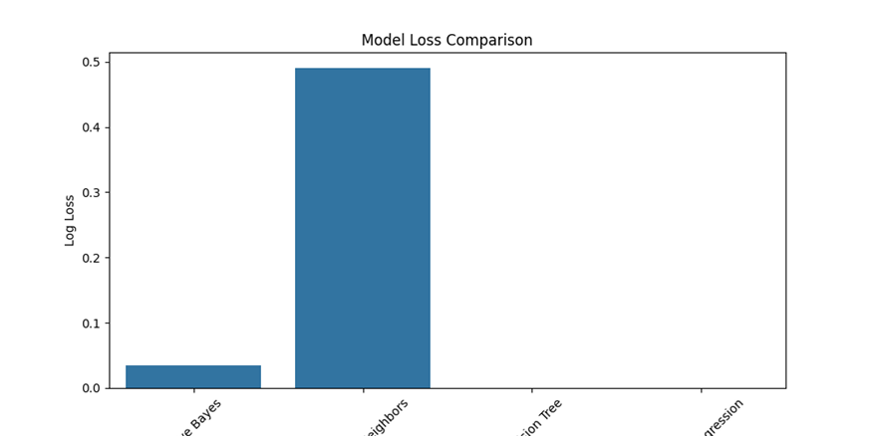
Results Part 2
For log loss, Logistic Regression again outperformed the others, which means that it not only predicted well but also provided reliable probability estimates.
These metrics, including confusion matrices and visual comparisons, helped assess the overall reliability of each model.

Slide 11
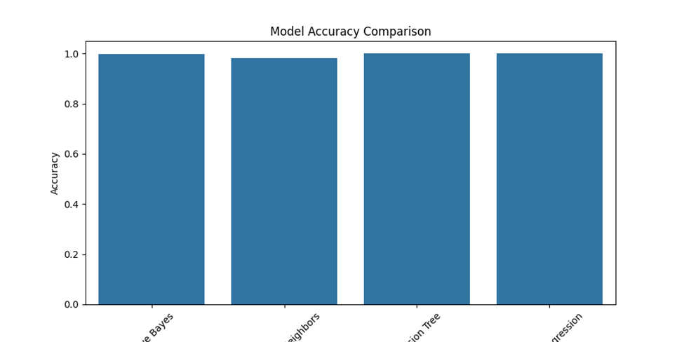
Results Part 3
Logistic Regression achieved the highest accuracy, demonstrating its effectiveness for this type of classification problem, while K-Nearest Neighbors and Naive Bayes also performed well but a little bit lower.
Decision Tree, even though it can capture complex patterns, resulted in less accuracy compared to the other models.

Slide 12
Lessons Learned
Through this project, I learned the importance of selecting appropriate models for classification tasks and the impact of preprocessing steps like feature scaling and encoding on model performance.
One key lesson was the need to balance the complexity of the model with the size and quality of the dataset, because overfitting and underfitting can significantly affect results which is why the Decision Tree model was not successful.

Slide 13
Future Work
In the future, I would explore more advanced techniques like ensemble learning or deep learning to further improve accuracy for detection.
Also, expanding the dataset and implementing more features could lead to better analysis and insight of the models.

Slide 14
Summary
Overall, I developed and evaluated four machine learning models to detect ransomware and related threats using a dataset of benign and malicious events.
Logistic Regression demonstrated the highest accuracy, while Decision Trees provided the most reliable probabilistic predictions or the lowest log loss.
The results indicate that machine learning can effectively help classify cybersecurity threats.

Slide 15
References

